Slide 1
Neural representation of self-motion: internal vs. reafferent origin

Slide 2
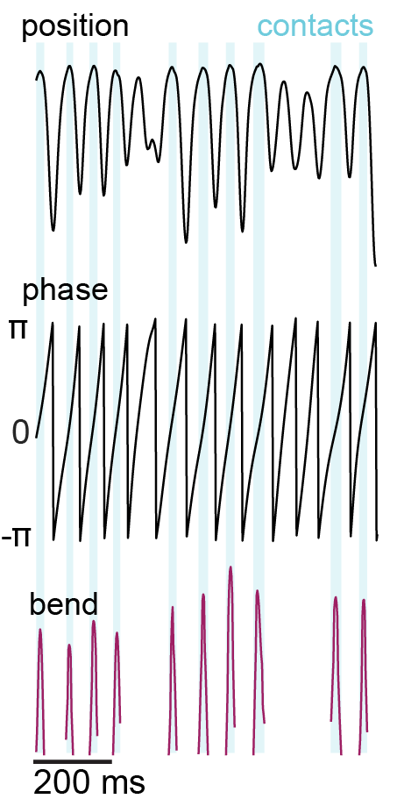
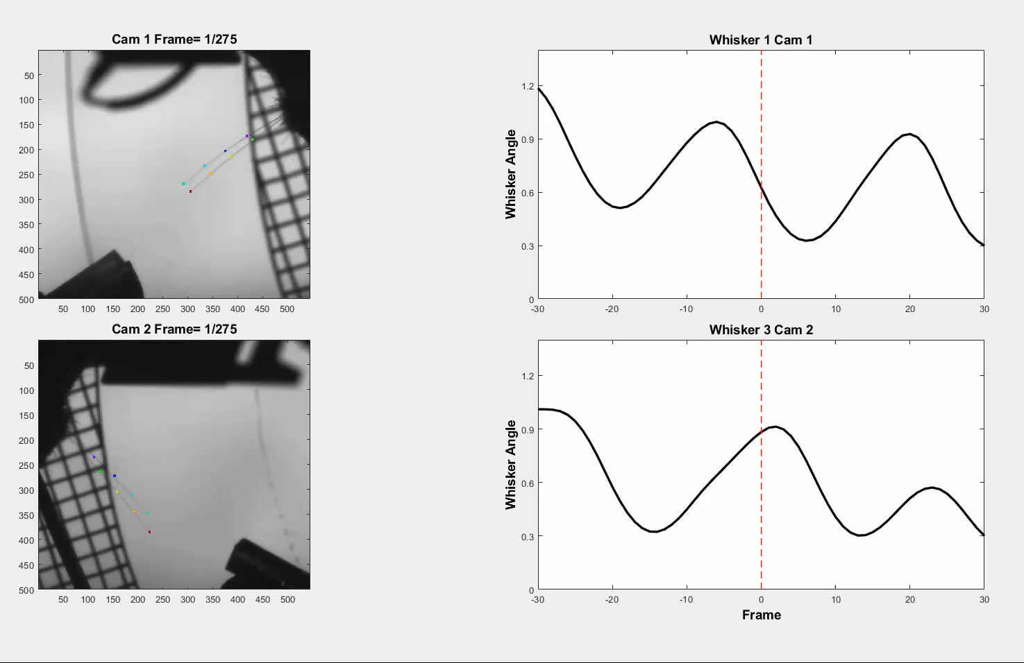

Extracting whisker kinematics

Slide 3
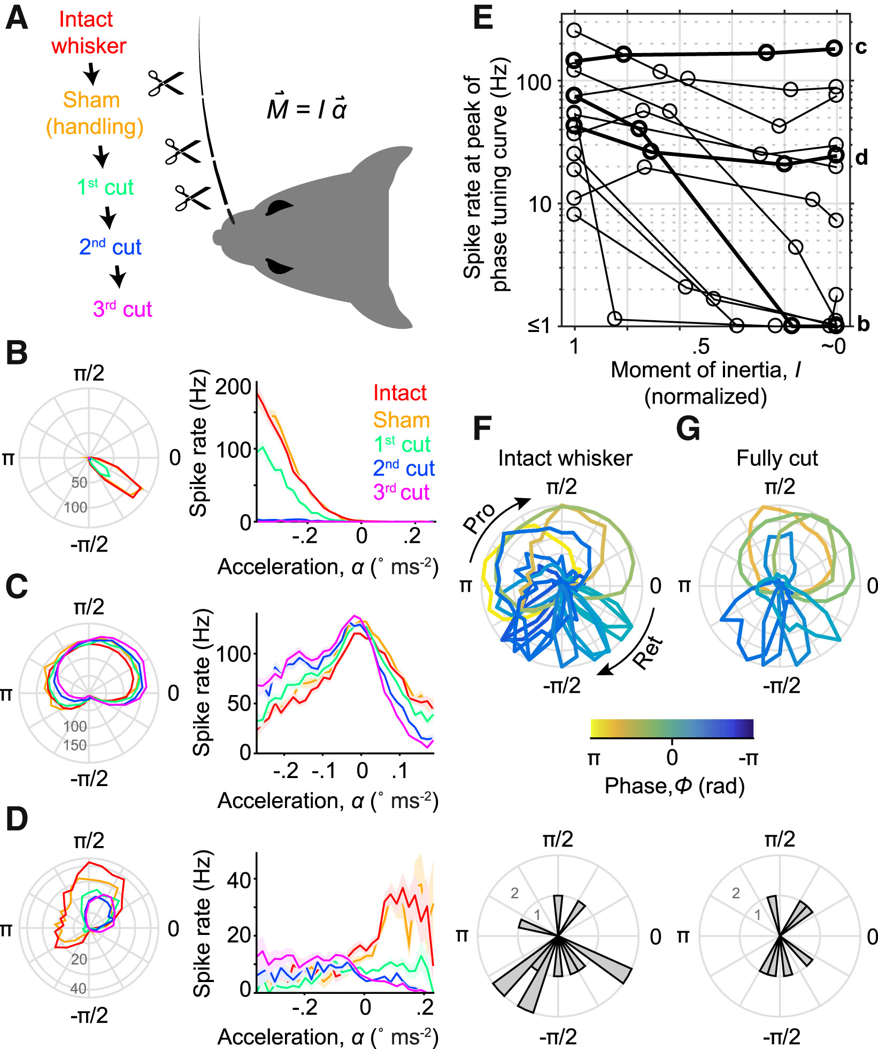
Minimally invasive manipulation of sensory reafference
Severson…O’Connor, 2017

Slide 4
Phase tuning in S1 requires reafference
Fee, Mitra, Kleinfeld, 1997

Slide 5
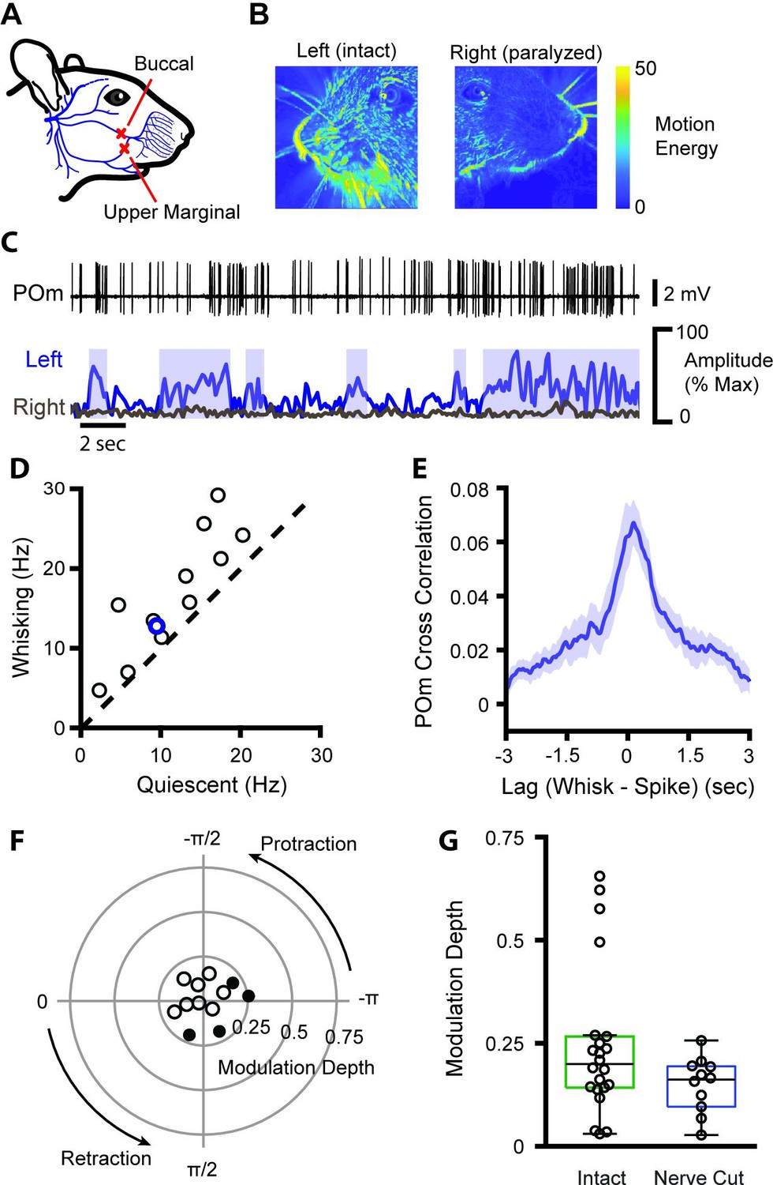
Amplitude tuning in thalamus (Po) originates internally
Petty…Bruno, 2021

Slide 6
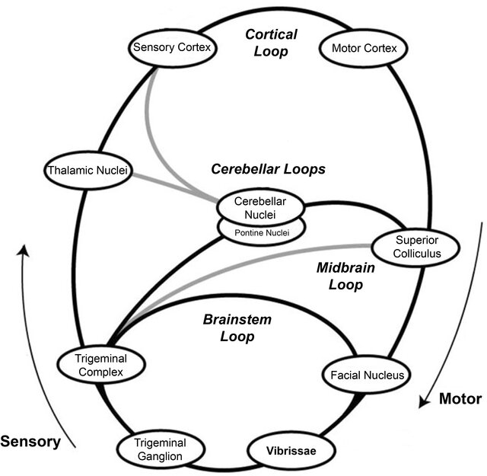
Mitchinson….Prescott, 2012

