Slide 1
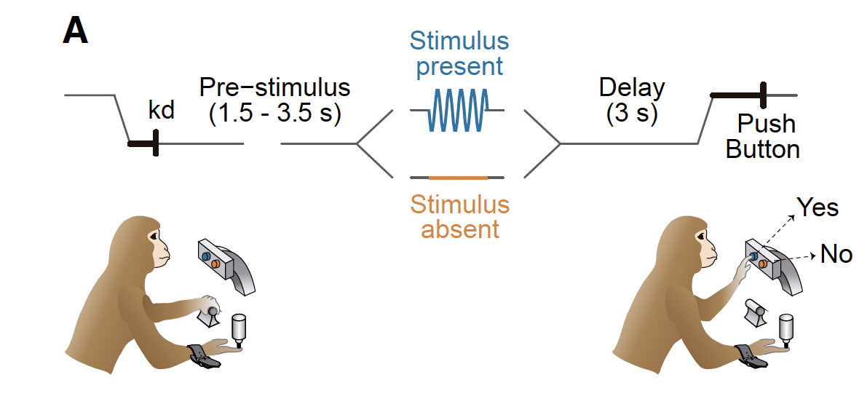
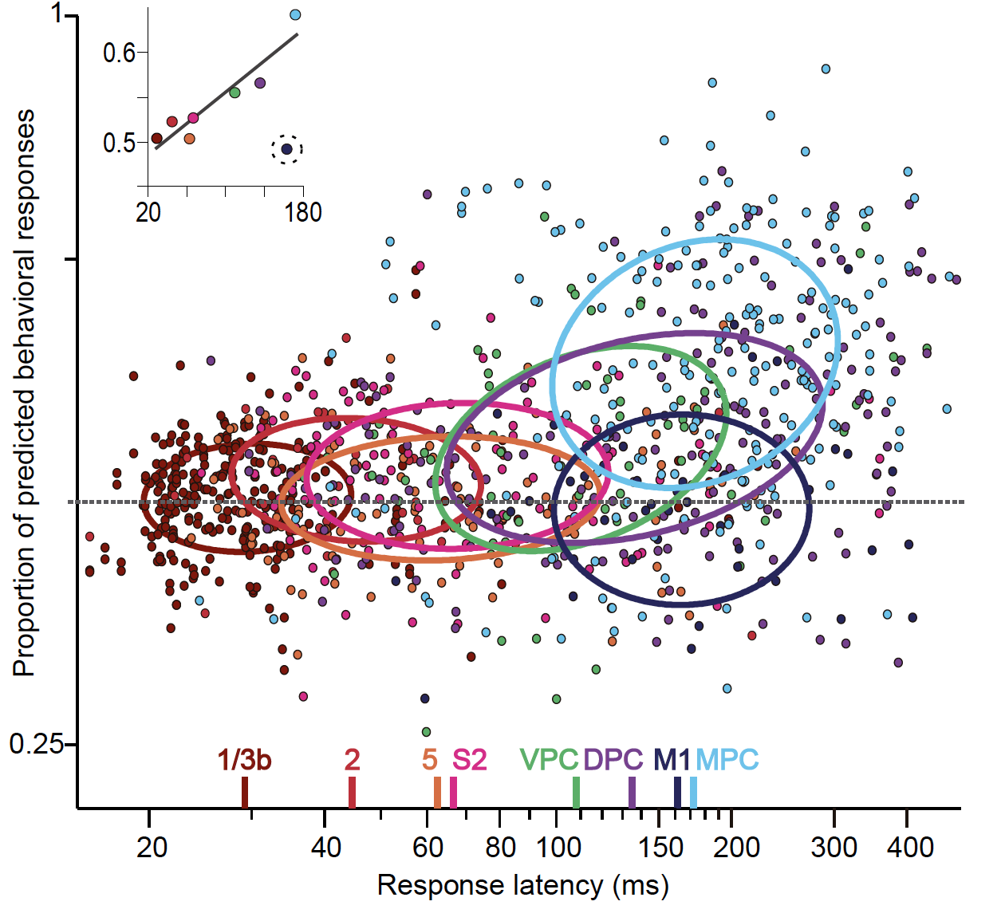
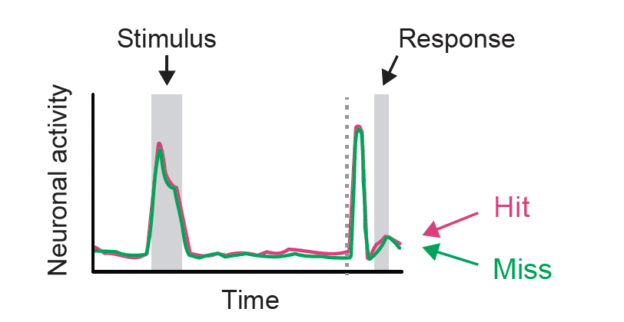
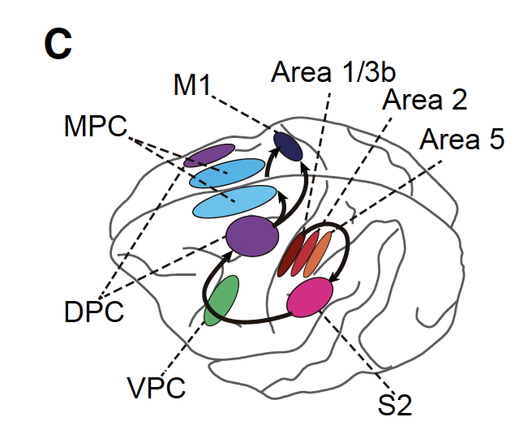
Inspiration: Reviewer #2, “Sensory decision-making and the learning of stimulus-response contingencies have been attributed to “higher” cortical areas and not to primary sensory ones.”; “Evidence in macaques suggests that neural responses in S1 are relatively impervious to task demands”
de Lafuente & Romo, 2005
Romo & Rossi-Pool, 2020

Slide 2
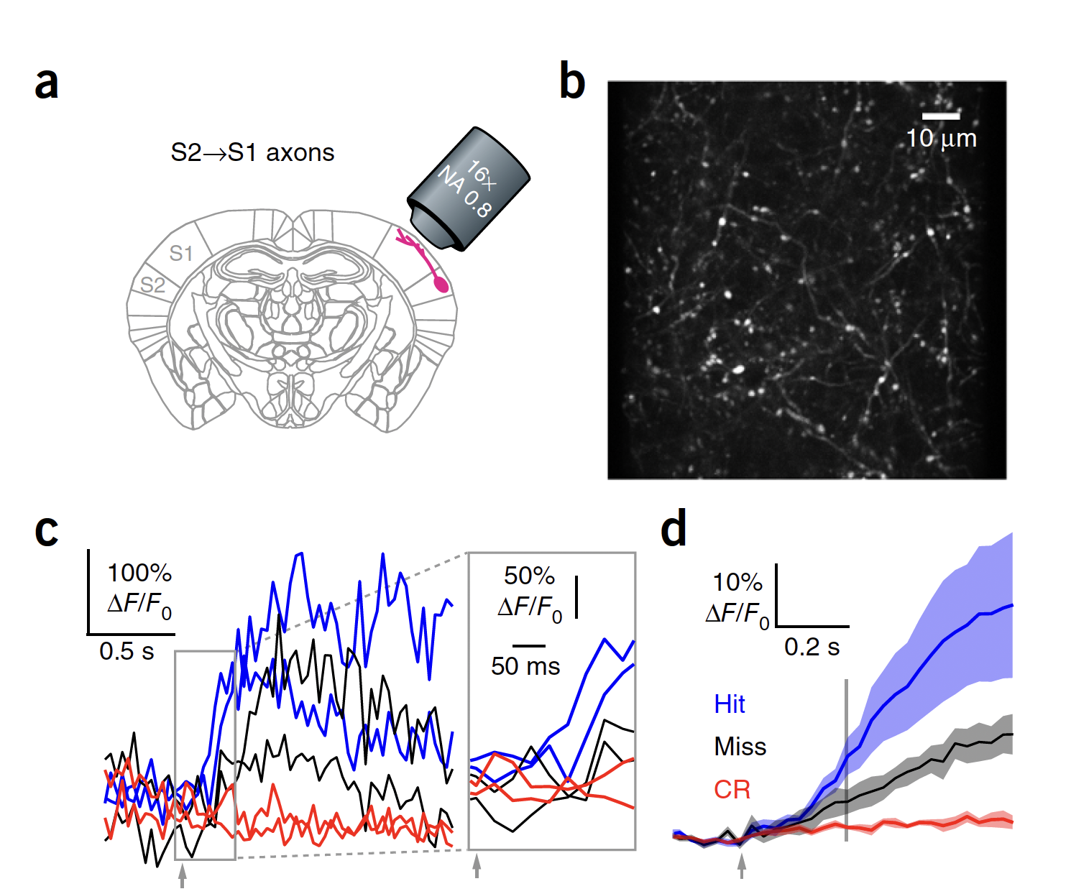
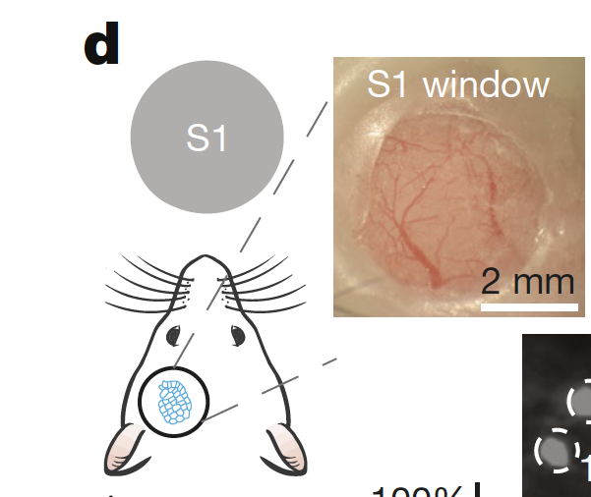
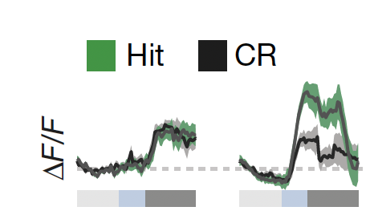
Inspiration: Reviewer #1, “Sensory decision-making and the learning of stimulus-response contingencies have been attributed to “higher” cortical areas and not to primary sensory ones.”; “Evidence in macaques suggests that neural responses in S1 are relatively impervious to task demands”
Naive
Expert
Yang & O’Connor, 2016
Banerjee et al., 2020

Slide 3
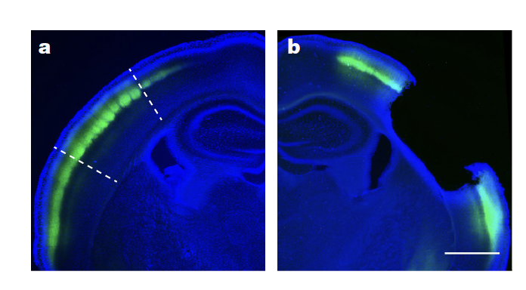
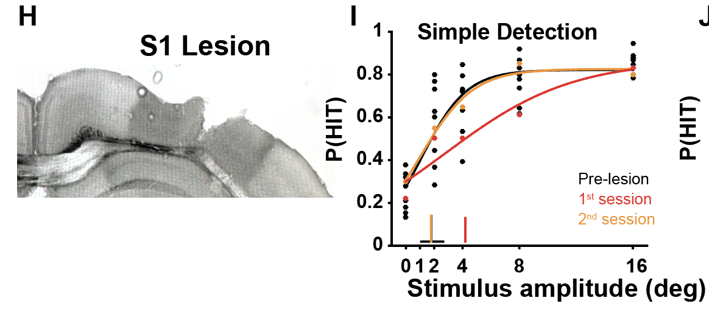
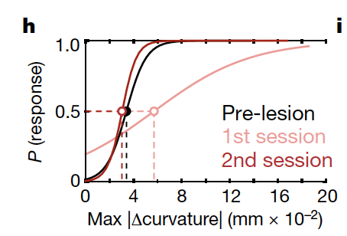
Inspiration: Reviewer #3, “It is awkward to state the S1 is not needed for detection, but then design an entire program of study to characterize S1 responses during detection.”
Waiblinger et al., 2022
Hong et al., 2018

Slide 4
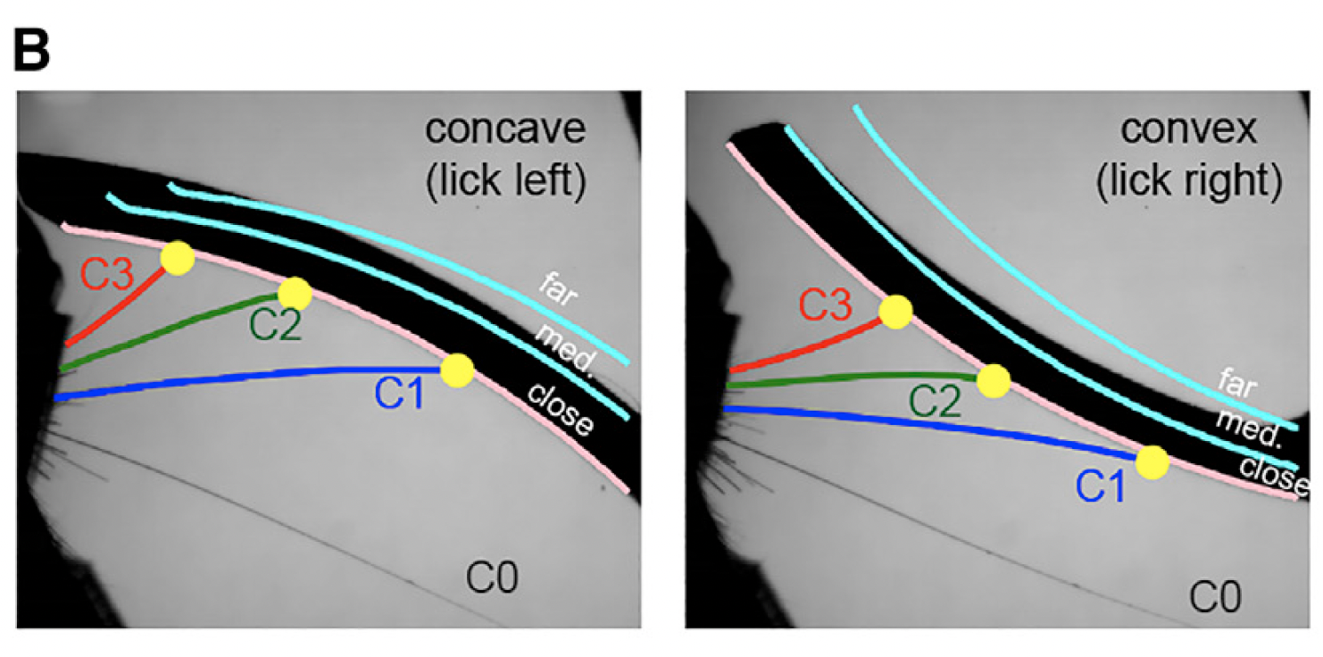
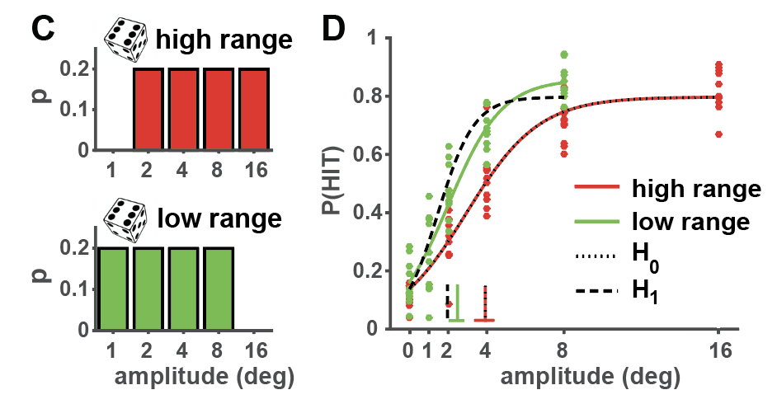
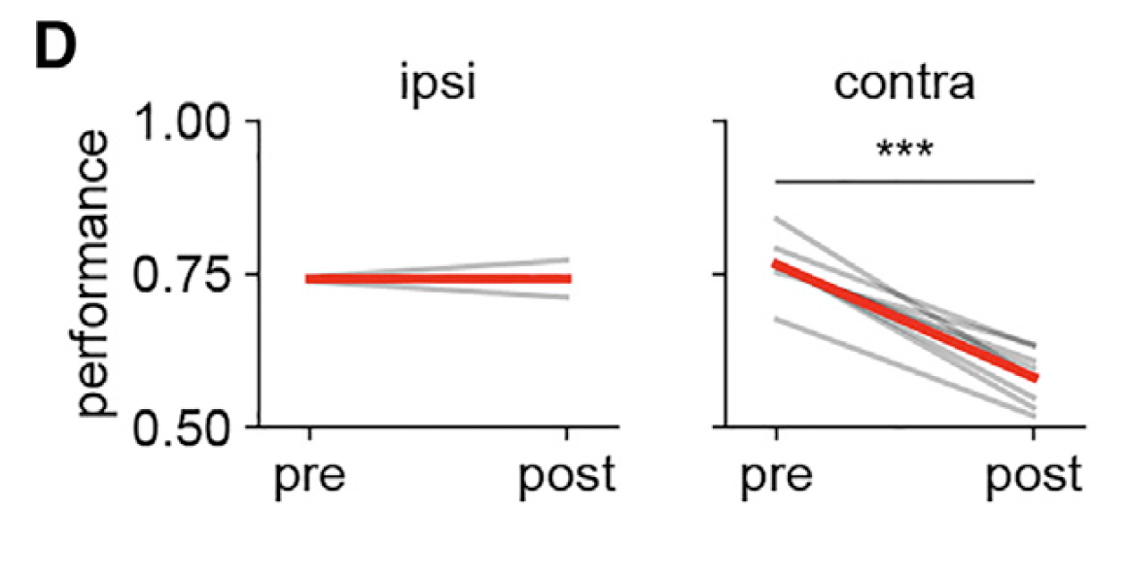
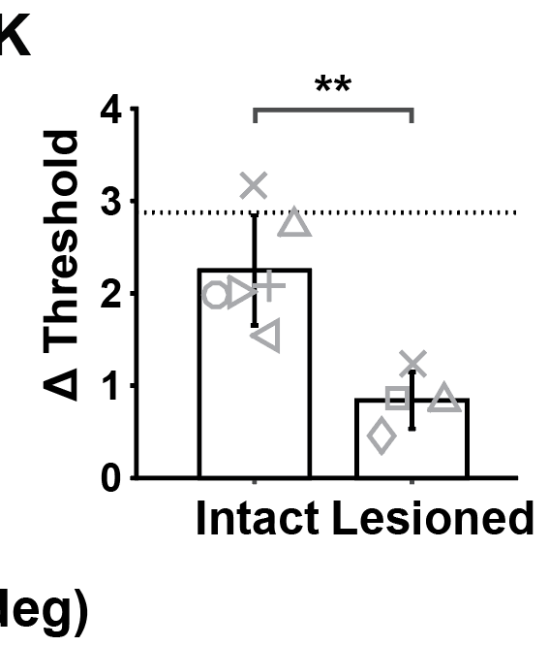
Inspiration: Reviewer #1, “It is awkward to state the S1 is not needed for detection, but then design an entire program of study to characterize S1 responses during detection.”
Rodgers et al., 2021
Waiblinger et al., 2022

